Slide 1
COBARA browser
Luca Collorone, Marco Raffaele, Tommaso Battistini

Slide 2
What is COBARA browser?
Hand gesture and voice controlled browser

Slide 3
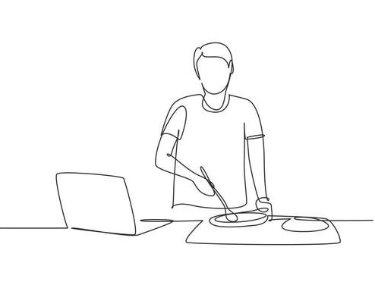
Why Cobara Browser?
In case you have dirty hands and can’t touch your screen/controller
In case you want to avoid touching the device
itself. For example, in case of
public devices for sanitary reasons.

Slide 4
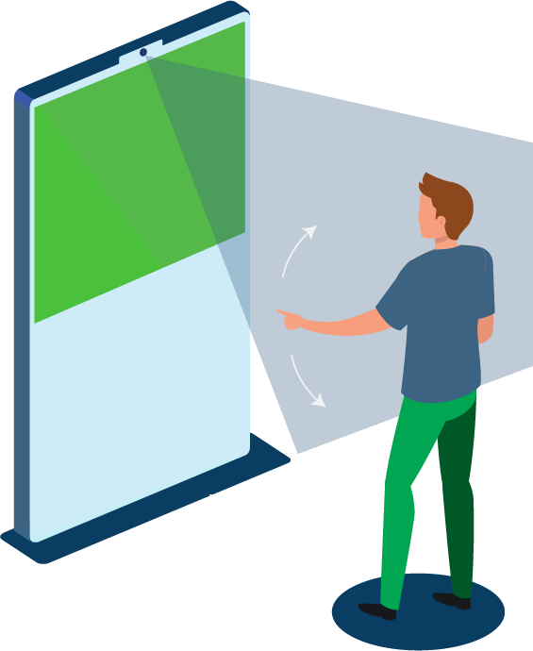
Why Cobara Browser?
In case you have dirty hands and can’t touch
your screen/controller
In case you want to avoid touching the device itself. For example, in case of public devices for sanitary reasons.

Slide 5
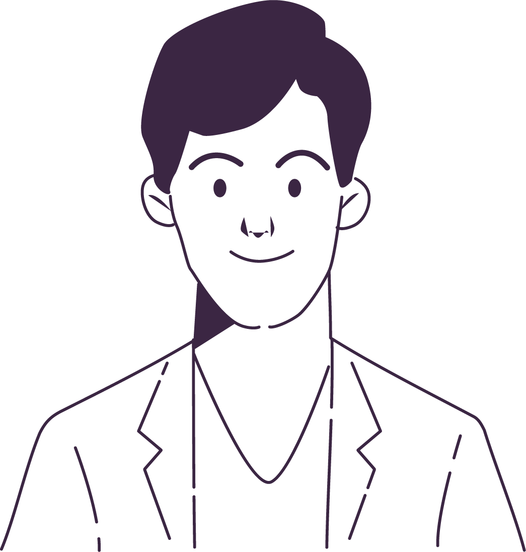
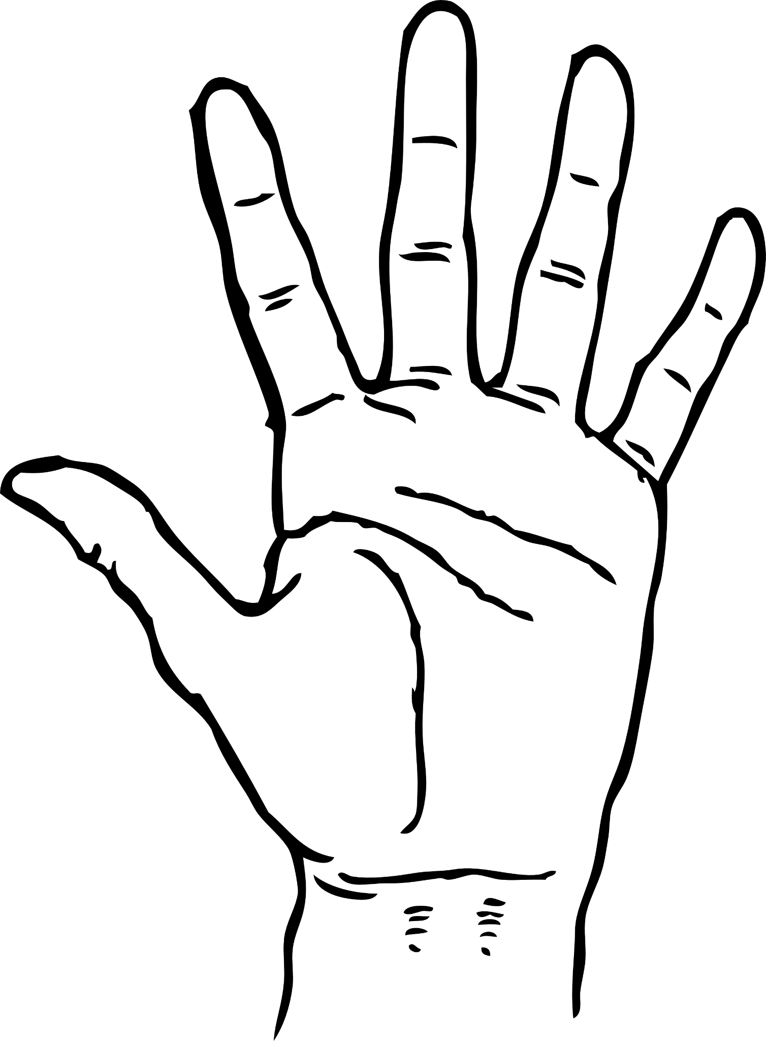

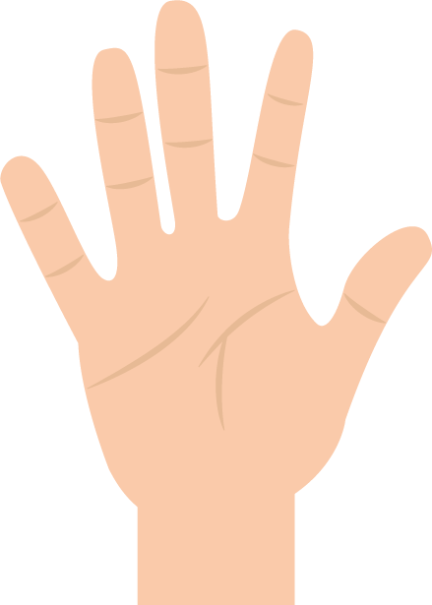
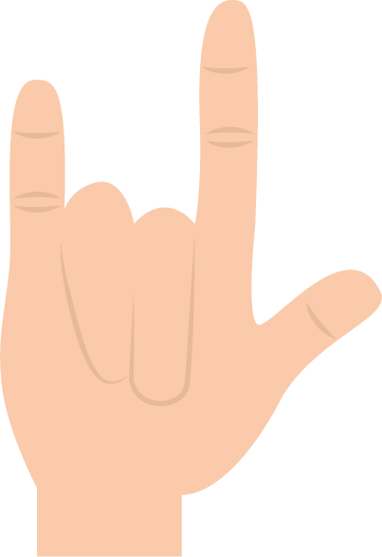

Functionalities:
Background Start
Face recognition
Dominant Hand Precedence
Gesture Control
Mouse movement
Click
Right Click
Tab Switch
Scroll up/down
Screenshot
Voice Input
COBARA browser

Slide 6

FUnctionality: Background start
The browser starts in the background, and can be activated by a simple hand gesture.
Show both palms to the camera to start.

Slide 7
Functionality: Face recognition
Face recognition allows Cobara to register Users in the system.
It also allows access to already registered users, and remembers the tabs they left open and their hand preferences.

Slide 8
Functionality: Dominant Hand priority
While the browser can be operated with both hands, the dominant one always has priority.
Cobara has been designed this way in order to be resistant to unvolontary non-dominant hand gestures.

Slide 9
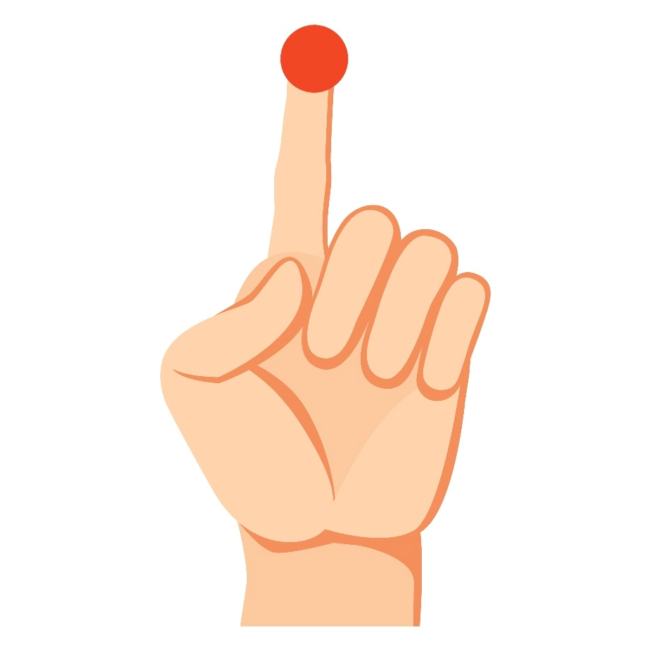
Functionality: Gesture Controls
1: Mouse movement
The Camera will detect your index if you raise it while keeping the rest of your hand close. The tip of your finger will be followed by the on-screen cursor!

Slide 10
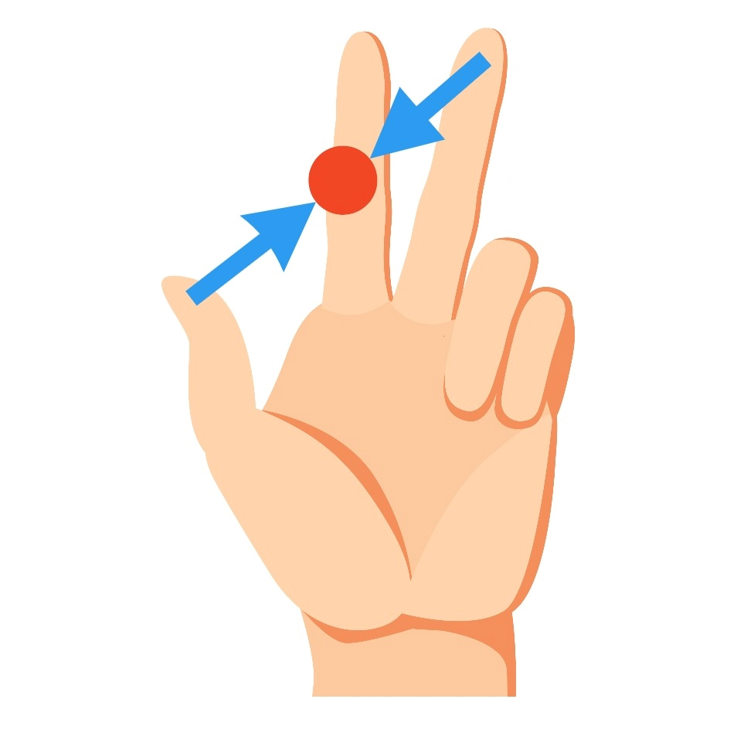
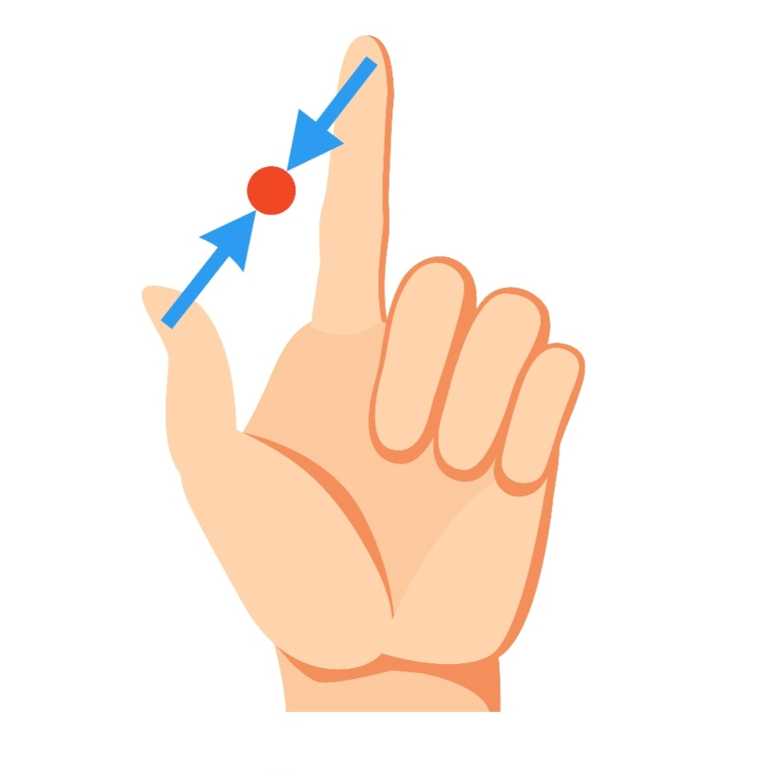
Functionality: Gesture Controls
2: Left Click can be performed by pinching your index and your thumb.
3. Right Click works in the same way as the left click, but you need to keep your middle finger up as well.

Slide 11
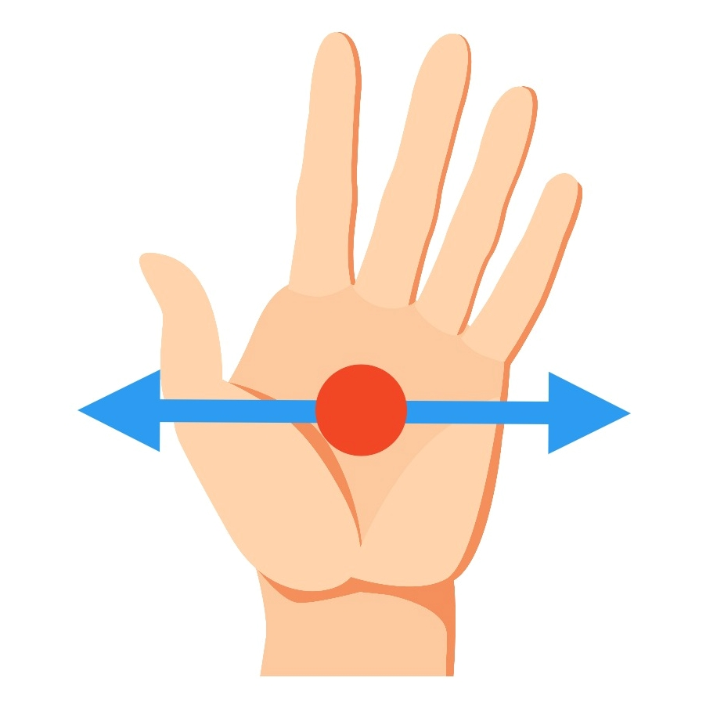
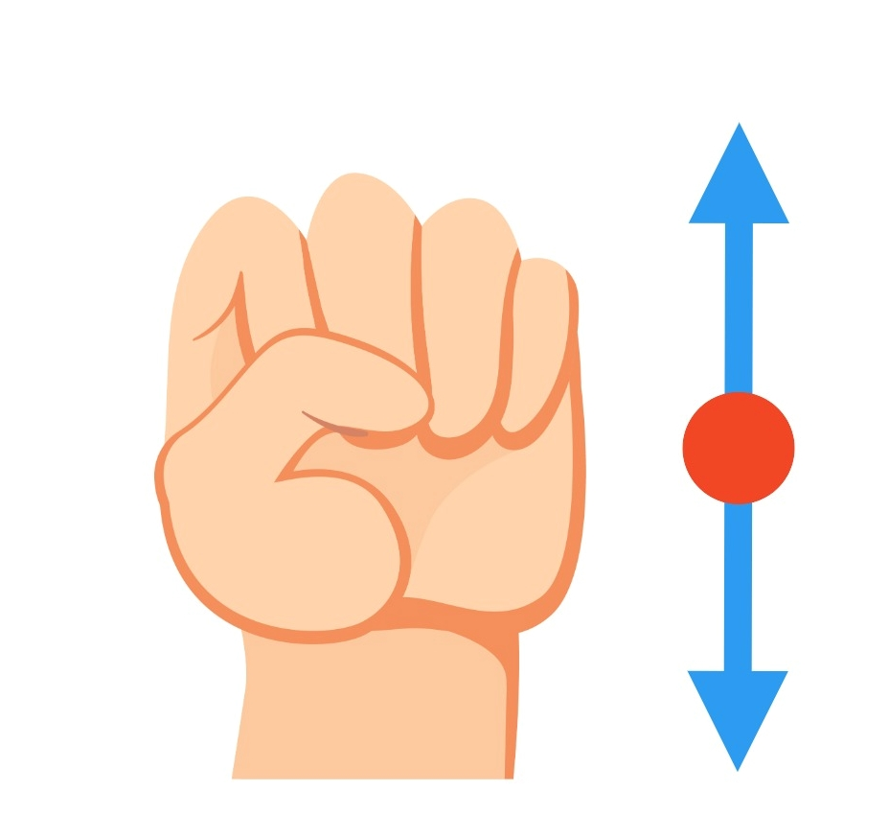
Functionality: Gesture Controls
4: Tab switch can be performed by keeping your hand open and moving it sideways
5: Scrolling works in a similar way, but you need to keep your hand closed, and the movement is vertical

Slide 12
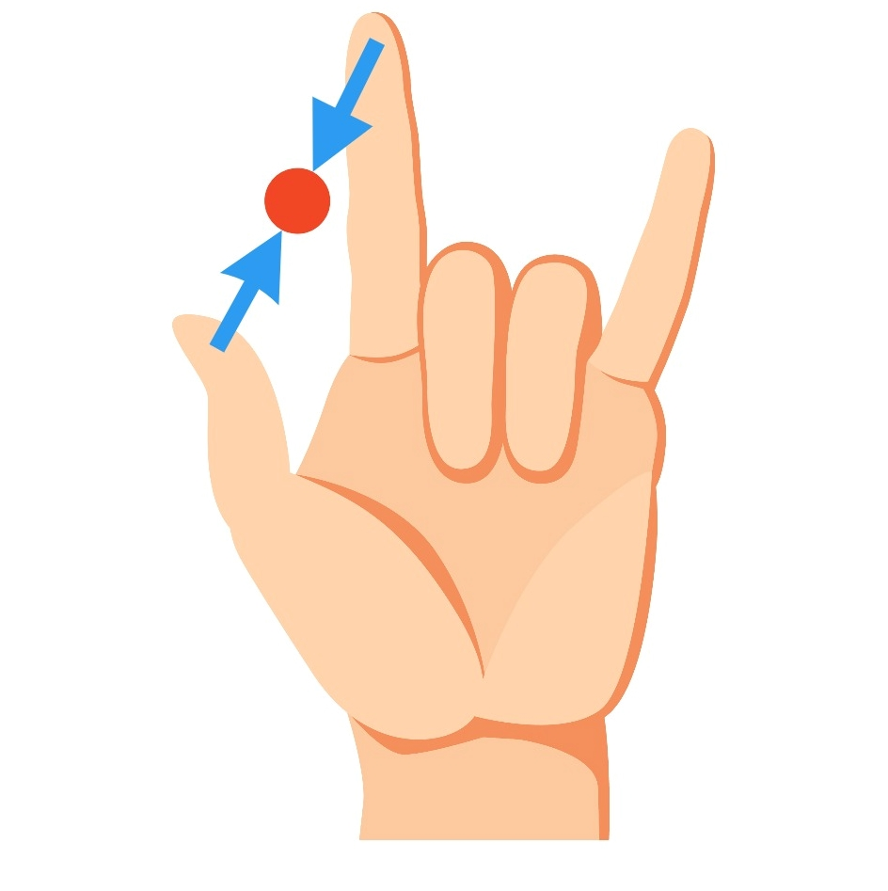
Functionality: Gesture Controls
6: Screenshots can be made by pinching your index and thumb while holding your little finger straight.
After performing a screenshot, you can find the output image in the” BrowserScreenshot” Folder.

Slide 13

Functionality: Voice input
While using web browsers, we often need to write text into search boxes.
In the first iterations of Cobara’s development we displayed a keyboard for users to manually write text. This process was slow and fatiguing.
On the other hand, voice input showed to be intuitive and effective.

Slide 14

Functionality: Sounds
Sounds have been designed and recorded in order to suggest the meaning of the action they are associated with.
This means there are ascending intervals for starting sounds, descending intervals for closing ones.
Sounds are triggered when:
Start Program
Close Program
Voice input start
Voice input end

Slide 15
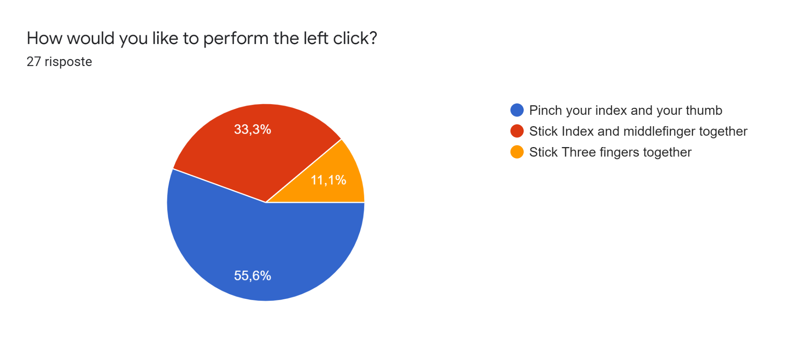
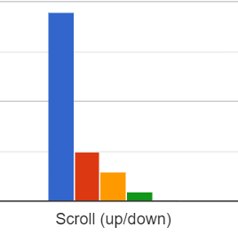
Iterations and tests
The first iterations were driven by the feedback we received from a Form. During this stage we made the following changes:
Chose click gesture
Added Scrolling functionality

Slide 16
Iterations and tests
While conducting tests, we realized that users sometimes forgot gestures after using them; we therefore decided to add a toolbar to the right to remind them.
Also, at this stage we noticed that displaying a keyboard on screen was making it hard for users to type text into search boxes, and therefore implemented voice input.
Lastly, we added sounds, for the user to get some kind of feedback from Cobara while starting / closing functionalities.

Slide 17
Thank you
Luca collorone
Marco Raffaele
Tommaso Battistini

